Slide 1
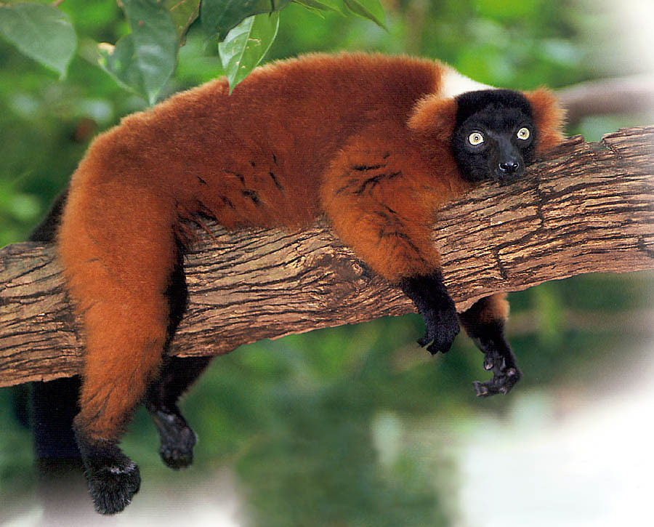
Week of 10/23 Deliverables
Red Lemurs

Slide 2
Deliverables
Lemur library alpha
notebook
C-PAC on fMRI -- issues running C-PAC on HBN data
notebook
Parametric Models for Multivariate Time Series Exploration
pdf
Copula for Intra-Dependence in Time Series
notebook

Slide 3
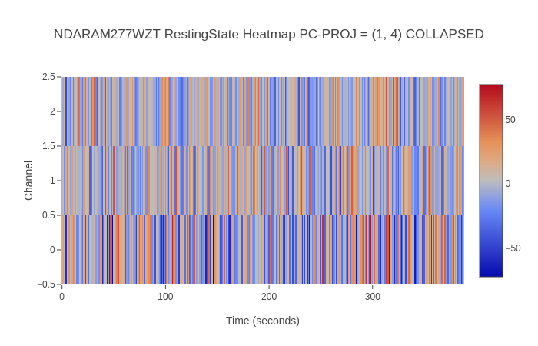
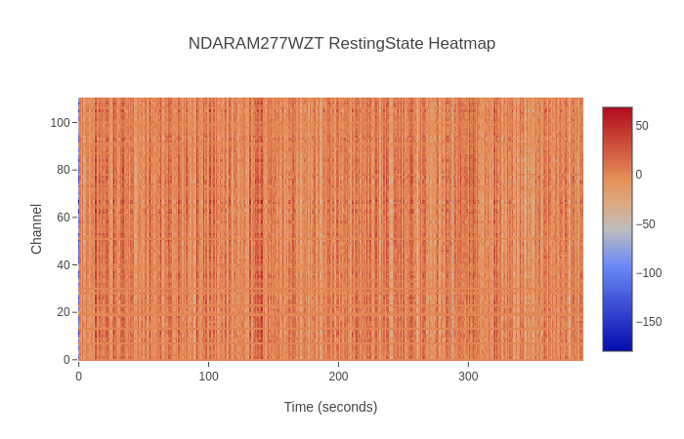
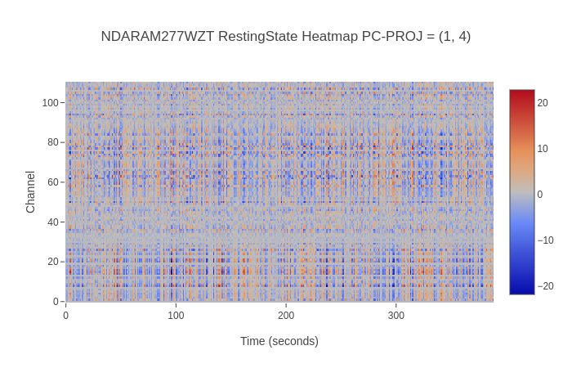
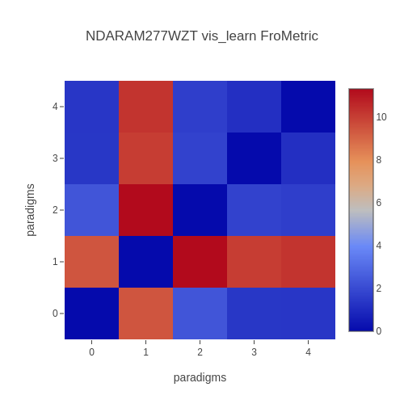
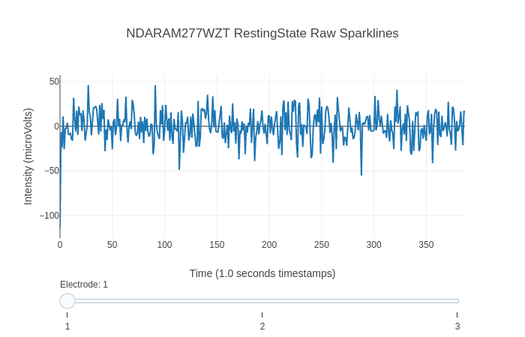
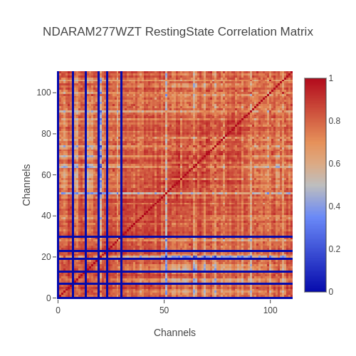
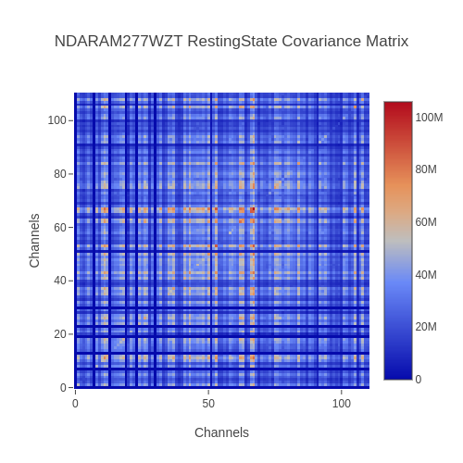
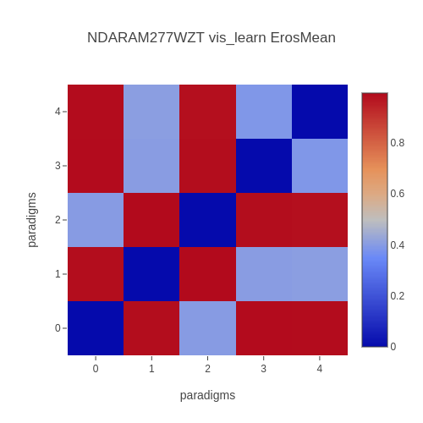
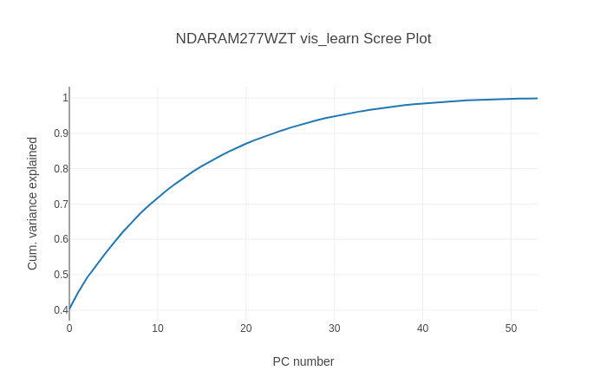
Lemur Alpha Library😄notebook

Slide 4
Running C-PAC on fMRI
Tried to install C-PAC locally but failed
Switched to Docker
fMRI data in BIDS form (resting state)
Outputs mainly include preprocessing results
Several crushes
Memory intensive?
Missing info (SliceTiming) in data?
Notes:
https://www.ncbi.nlm.nih.gov/pmc/articles/PMC2880795/

Slide 5
Parametric Models for Multivariate Time Series
DoD: https://github.com/NeuroDataDesign/lemur-f17s18/blob/master/docs/vidurkailash/NeuroData_Multivariate_Time_Series_Models.pdf
Link to Papers: file:///Users/vidurkailash/Downloads/Detection-of-Changes-in-Multivariate-Time-Series-With-Application-to-EEG-Data.pdf
https://books.google.com/books?id=joodLUTyIEYC&pg=PA146&lpg=PA146&dq=multivariate+time+series+eeg&source=bl&ots=6wzdKTjXg6&sig=GBOFtnY8lIocQeo8Ni0uFzB5n_U&hl=en&sa=X&ved=0ahUKEwjpxvnw4oXXAhUL5yYKHW-tBTw4ChDoAQgrMAI#v=onepage&q=multivariate%20time%20series%20eeg&f=false

Slide 6
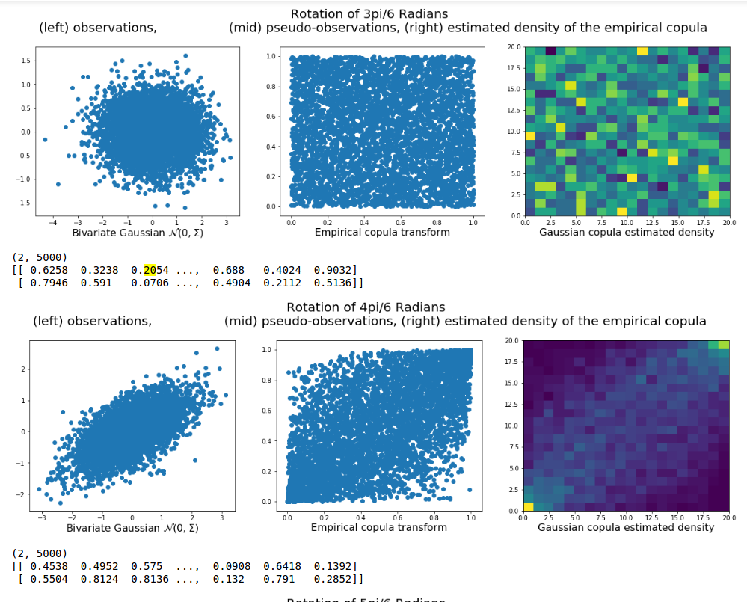
Copulas
Main Idea:
We know more about the marginals than joint
Normalize the marginals
Analyze the joint relationship more easily

Slide 7
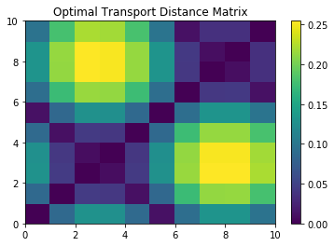
Copula Distance Matrix

Slide 8
Next Week
Create a function to compute a coherence matrix
Implement and test ARMA models on our data
Improve data generation functions, create a battery of tests for an arbitrary distance metric (rotation invariant, scale invariant, translation invariant, etc.)
Figure out whether C-PAC issue is on our end, if not find a different way to get connectivity information

